Slide 1

DETECT FRAUDULENT CREDIT CARD TRANSACTIONS
2
+
Project 2

Slide 2


TEAM MEMBERS
2
+
2
+
Andrew Park
Cornelius Hattingh
Fareed Freihat
Jada Williams
Lynette Cary
Marius Nsamou

Slide 3

WHY FRAUD DETECTION?
2
+
“Fraud detection today involves a comprehensive approach to match data points with activities to find what is abnormal and to learn from complex data patterns using sophisticated decision models to better manage false positives.”¹
In 2019, Credit Card Fraud was ranked as the #1 identity theft across the U.S. accounting for approximately $135 million according to the U.S. Federal Trade Commission 2019 data book. ²
¹ Source: SAS Institute, Inc. https://www.sas.com/en_us/insights/fraud/fraud-prevention.html
²Source: U.S. Federal Trade Commission 2019 Consumer Sentinel Network Data Book https://www.ftc.gov/system/files/documents/reports/consumer-sentinel-network-data-book-2019/consumer_sentinel_network_data_book_2019.pdf

Slide 4

PROJECT FOCUS
2
+
Credit Card Transactions
Using machine learning methods and past credit card transactions to answer the following questions:
Are the transactions in the dataset correctly classified as valid or fraudulent?
Can training the data and testing the model detect fraudulent activity?
What model performs the best based on the AUC and F1-Score?

Slide 5
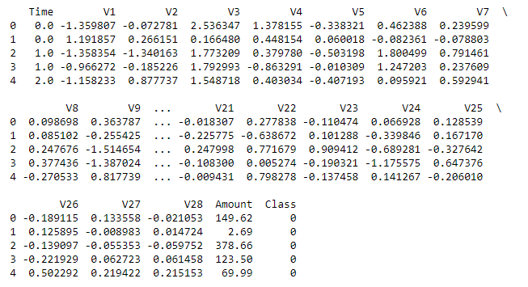
DATASET
Data Source: Kaggle
Dataset: Credit Card Transactions made by European cardholders over 2 days in September 2013
Dataset includes:
284,807 transactions
28 variables PCA-decomposed and anonymized to protect customers’ identities except for Time recorded in seconds and Amount in Euros
Class categorized as 0 = Non-Fraudulent and 1 = Fraudulent
Highly imbalanced dataset

Slide 6
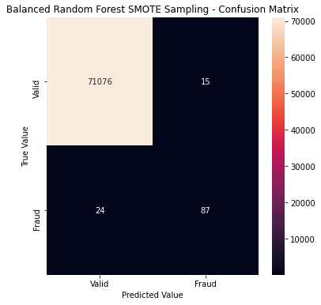
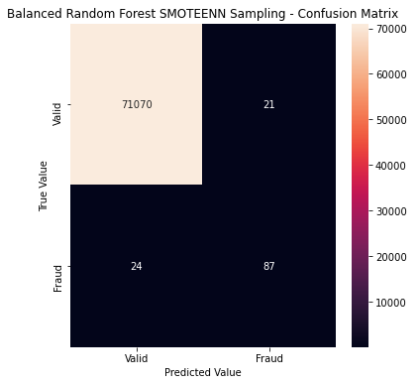
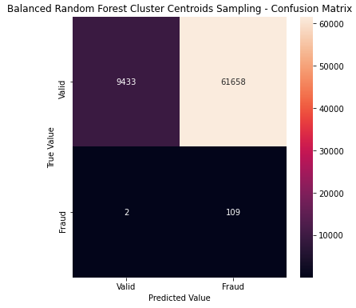
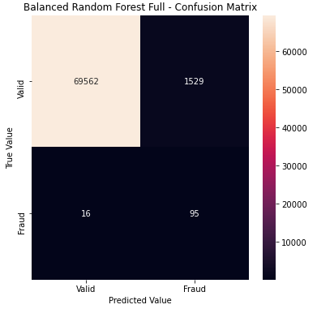
CLASSIFICATION ALGORITHMS –BALANCED RANDOM FOREST
AUC: .99945
F1-Score: .81690
Accuracy: .89179
AUC: .99937
F1-Score: .79452
Accuracy: .89174
SMOTE sampling had the best overall performance of AUC, F1-Score and Accuracy values
AUC: .13401
F1-Score: .97830
Accuracy: .55734
AUC: .97830
F1-Score: .10950
Accuracy: .91717

Slide 7
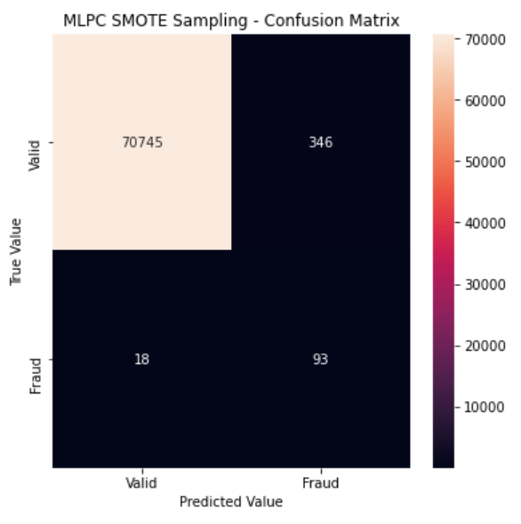
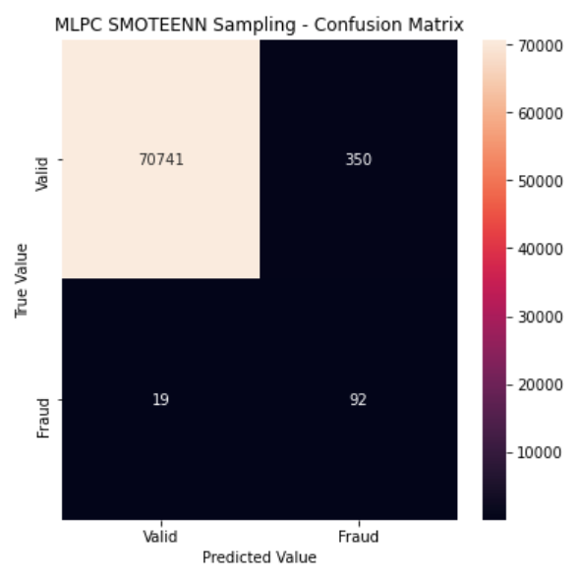
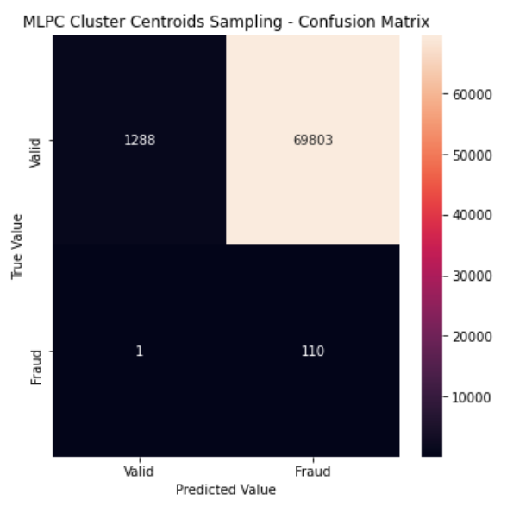
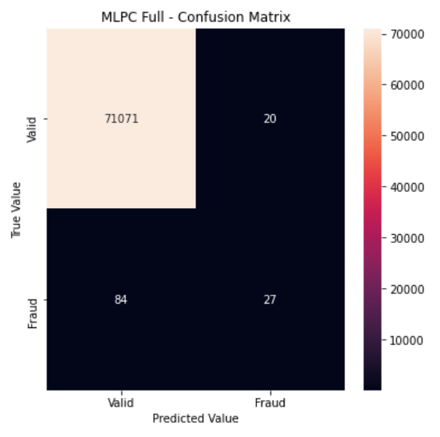
CLASSIFICATION ALGORITHMS – MULTI-LAYER PERCEPTRON CLASSIFIER
AUC: .99489
F1-Score: .33818
Accuracy: .91649
AUC: .99481
F1-Score: .33273
Accuracy: .91195
No Sampling had the best AUC and F1-Score while SMOTE sampling yielded the best accuracy value
AUC: .01963
F1-Score: .00314
Accuracy: .50455
AUC: .99854
F1-Score: .34177
Accuracy: .62148

Slide 8
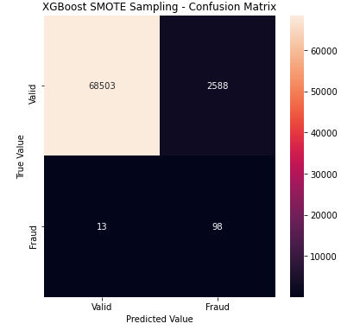
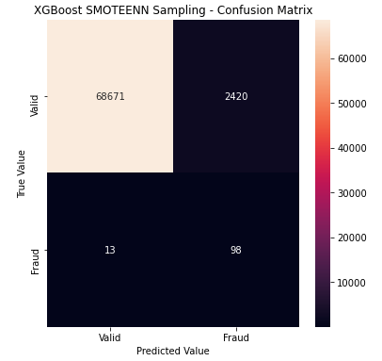
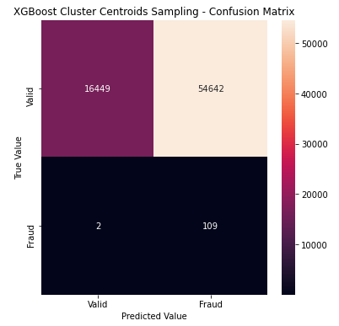

CLASSIFICATION ALGORITHMS – XGBOOST
AUC: .96348
F1-Score: .07008
Accuracy: .92324
AUC: .96590
F1-Score: .07455
Accuracy: .92442
No Sampling had the best AUC and F1-Score while SMOTEENN yielded the best accuracy value
AUC: .23255
F1-Score: .00397
Accuracy: .60668
AUC: .99926
F1-Score: .76444
Accuracy: .88719

Slide 9
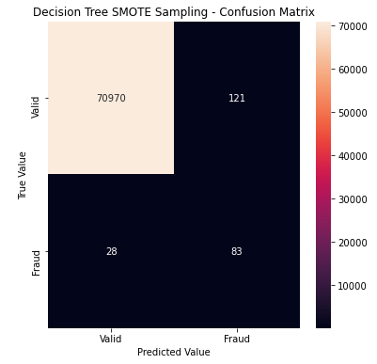
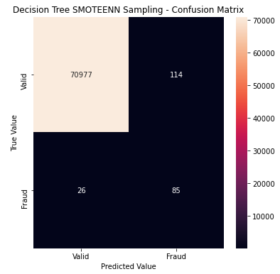
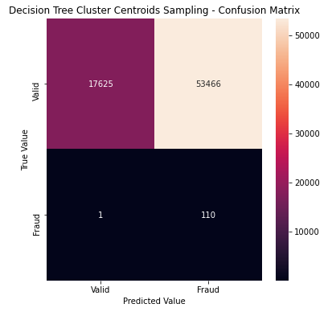
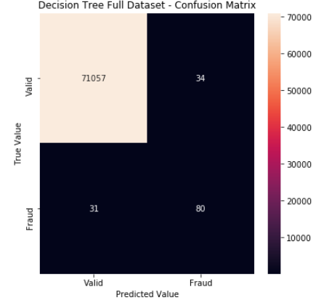
CLASSIFICATION ALGORITHMS – DECISION TREE
AUC: .99791
F1-Score: .52698
Accuracy: .87302
AUC: .99803
F1-Score: .54839
Accuracy: .88208
No Sampling had the best AUC and F1-Score while SMOTEENN yielded the best accuracy value
AUC: .24908
F1-Score: .00401
Accuracy: .61946
AUC: .99909
F1-Score: .71111
Accuracy: .86012

Slide 10
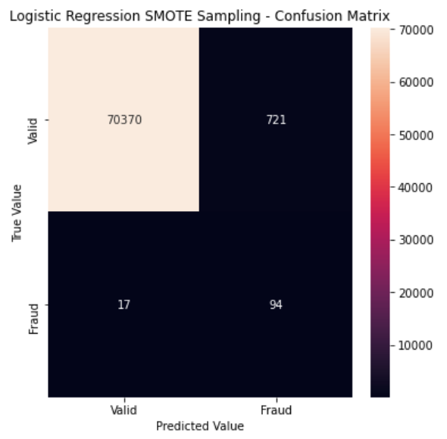
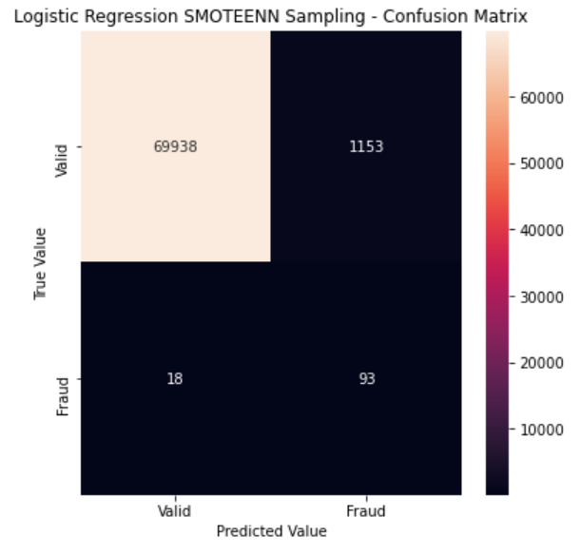
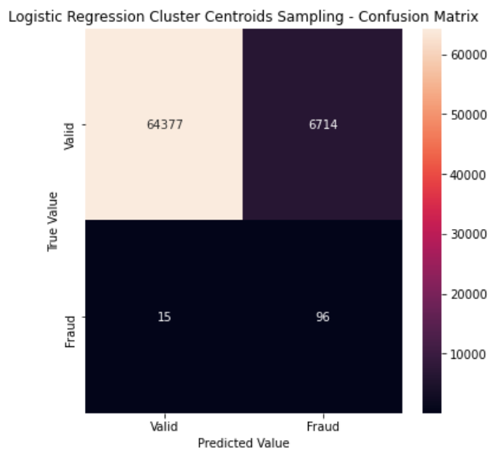

CLASSIFICATION ALGORITHMS – LOGISTIC REGRESSION
AUC: .99964
F1-Score: .20302
Accuracy: .91835
AUC: .98355
F1-Score: .13707
Accuracy: .91081
SMOTE sampling produced the best AUC and Accuracy while No Sampling yielded the best F1-Score
AUC: .90549
F1-Score: .02774
Accuracy: .88521
AUC: .99914
F1-Score: .68062
Accuracy: .79269

Slide 11
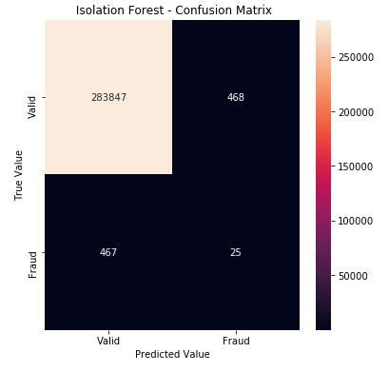
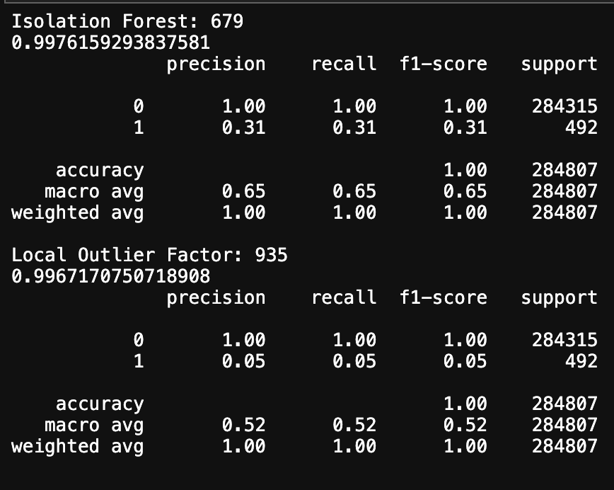
CLASSIFICATION ALGORITHMS – ISOLATION FOREST
AUC: .99672

Slide 12
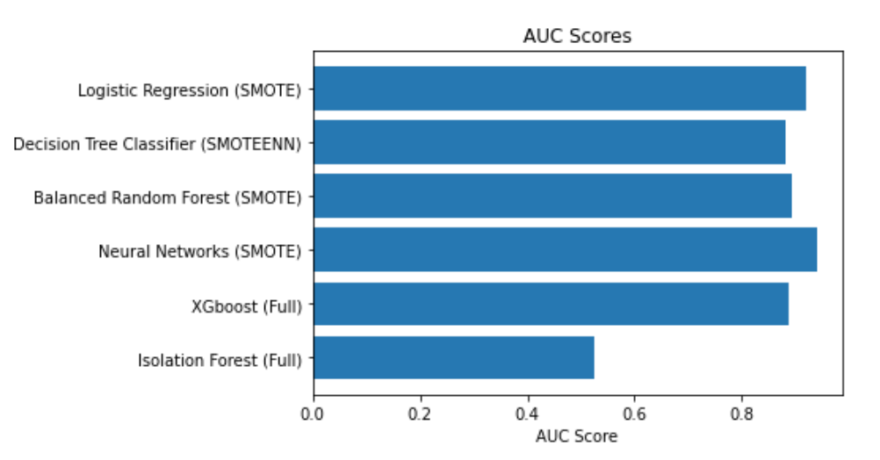
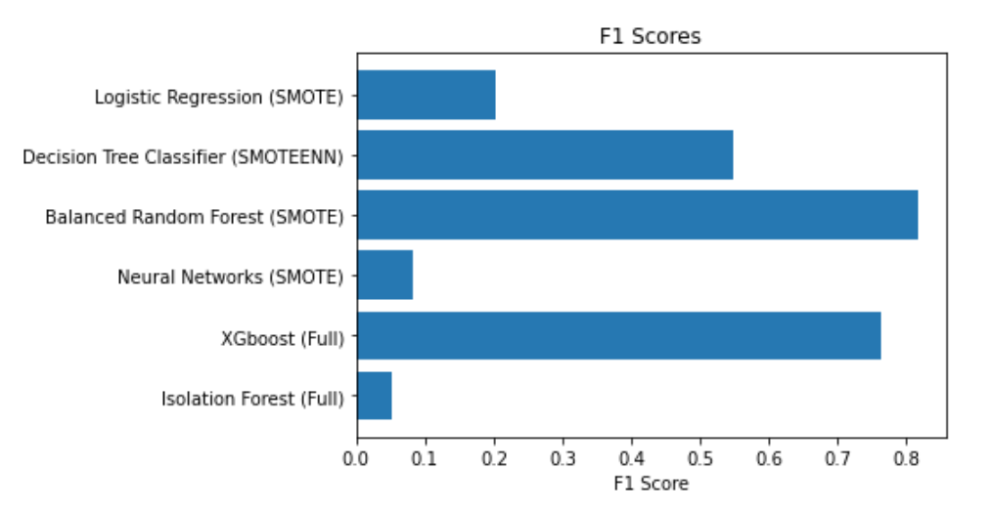
CONCLUSIONS
Logistic Regression SMOTE highest AUC Score .99964
Balanced Random Forest SMOTE highest F-1 Score .81690
XGBoost SMOTEENN highest Accuracy value .92442
Cluster Centroids performed worst overall

Slide 13
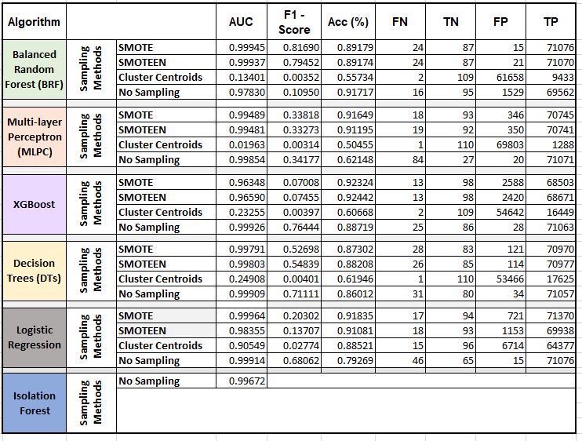
SUMMARY OF METRICS

Slide 14

Thank you!
2
+

